Slide 1
Resource Planning
Dr. Narpat Ram Sangwa
Assistant Professor
Operations & Supply Chain Management
IIM Sirmaur

Slide 2
Learning Objectives
How much of an item is needed to meet demand?
What are the various parts and components required?
When to order parts and components?

Slide 3
Resource planning
ERP- Enterprise Resource Planning
MRP II – Manufacturing
Resource Planning
MRP – Material
Requirements
Planning

Slide 4
Material Requirements Planning
Materials requirements planning (MRP) is a computerized inventory planning and control system for determining when (no earlier and no later) and how many of each of the parts, components, and materials should be ordered or produced.
It translates master schedule requirements of end items into time-phased requirements for subassemblies, components and raw materials.

Slide 5
Demand Characteristics
Independent Demand
(i.e. Finished goods)
A
Dependent Demand
(i.e. Components of finished goods)
B(4)
C(2)
D(2)
E(1)
D(3)
F(2)
Independent demand is uncertain.
Dependent demand is certain.
Dependent demand drives MRP.

Slide 6

Demand Characteristics
Independent demand
Dependent demand
100 x 1 =
100 tabletops
100 tables
100 x 4 = 400 table legs
400 –
300 –
200 –
100 –
Continuous demand
400 –
300 –
200 –
100 –
Discrete demand
No. of tables
No. of tables
1 2 3 4 5
Week
M T W Th F M T W Th F

Slide 7
MRP Core Concepts
Dependent Demand
Production (or procurement) of parts and materials is directly linked to demand for the final product
Time-phased Scheduling
Parts and components must be ordered in advance to accommodate lead times between order placement and receipt

Slide 8
Quick Review
True or False
Correct Answer: True
MRP is generally applicable to items with dependent demand.

Slide 9
Quick Review
True or False
Correct Answer: False
A dependent demand item is so called because its demand is dependent on customer preferences.

Slide 10
Quick Review
MCQ
Correct Answer: D
Dependent demand and independent demand items differ in that:
A) for any product, all components are dependent-demand items.
B) the need for independent-demand items is forecast.
C) the need for dependent-demand items is calculated.
D) All of the above are true.

Slide 11
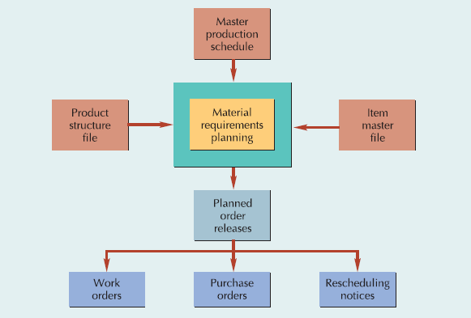
MRP Inputs and Outputs

Slide 12
Master Production Schedule
The master production schedule (MPS), also called the master schedule, specifies which end items or finished products a firm is to produce, how many are needed, and when they are needed.
The master production schedule works within the constraints of the aggregate production plan but produces a more specific schedule by individual products.
The time frame is more specific, too.
The total length of time required to manufacture a product is called its cumulative lead time.

Slide 13
Master Production Schedule
Drives MRP process with a schedule of finished products
Quantities represent production not demand
Quantities may consist of a combination of customer orders and demand forecasts
Quantities represent what needs to be produced, not what can be produced
Quantities represent end items that may or may not be finished products

Slide 14
Aggregate Production Plan
Months January February
Aggregate Plan 1,500 1,200
(Shows the total
quantity of amplifiers)
Weeks 1 2 3 4 5 6 7 8
Master Production Schedule
(Shows the specific type and
quantity of amplifier to be
produced)
240-watt amplifier 100 100 100 100
150-watt amplifier 500 500 450 450
75-watt amplifier 300 100

Slide 15
Product Structure File
Once the MPS is set, the MRP system accesses the product structure file to determine which component items need to be scheduled.
The product structure file contains a bill of material (BOM) for every item produced.
The bill of material for a product lists the items that go into the product, includes a brief description of each item, and specifies when and in what quantity each item is needed in the assembly process.

Slide 16
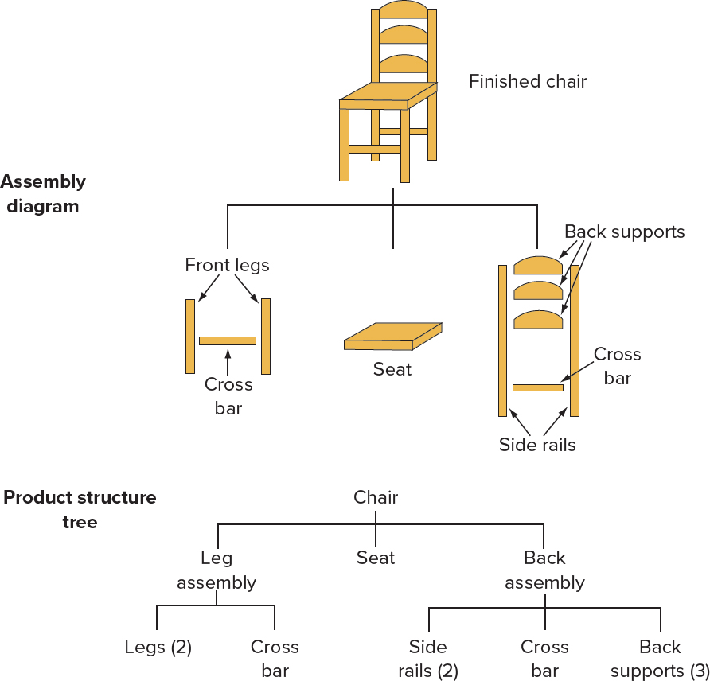
Product Structure File
Bill of Materials
Level |  | Quantity
0 | Chair | 1
1 | Leg assembly | 1
2 | Legs | 2
2 | Cross bar | 1
1 | Seat | 1
1 | Back assembly | 1
2 | Side rails | 2
2 | Cross bar | 1
2 | Back supports | 3

Slide 17
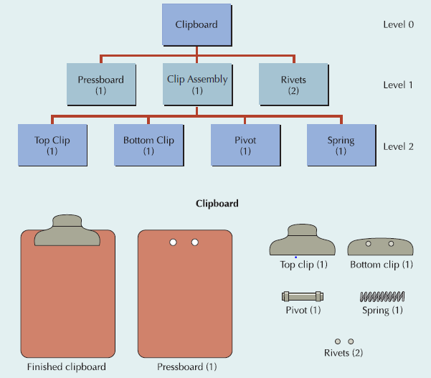
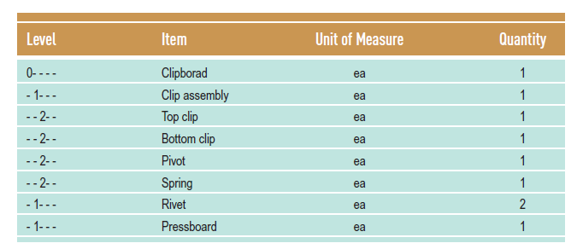
Product Structure File
Clipboard example

Slide 18
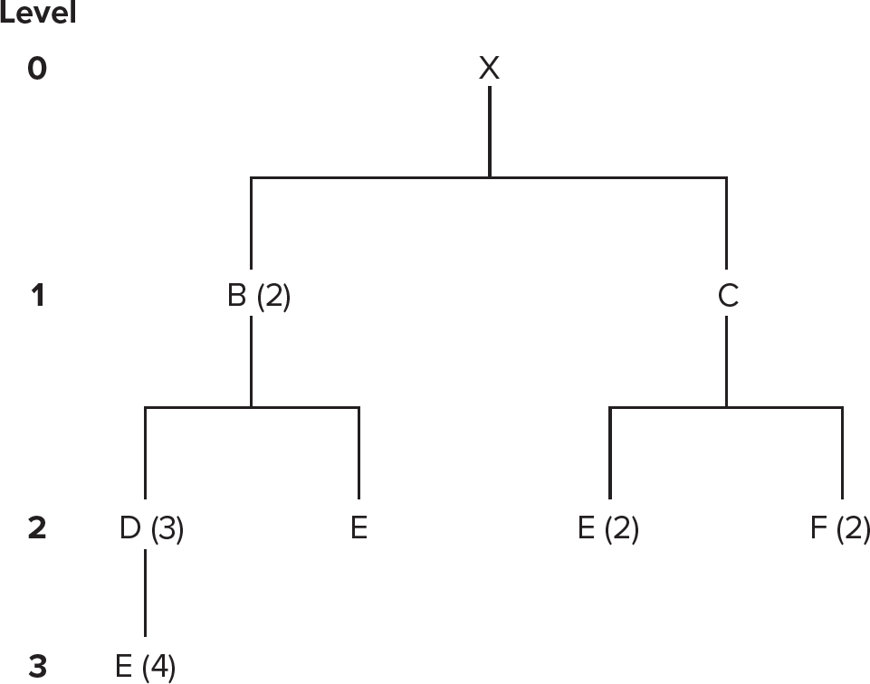
Low-Level Coding
Restructuring the bill of materials so that multiple occurrences of a component all coincide with the lowest level at which the component occurs.

Slide 19

BOM Example
For an order of 50 Awesome speaker kits
Level
Product structure for “Awesome” (A)
0
A
Part B: 2 x number of As = (2)(50) = 100
Part C: 3 x number of As = (3)(50) = 150
Part E: 2 x number of Bs
+ 2 x number of Cs = (2)(100) + (2)(150) = 500
Part F: 2 x number of Cs = (2)(150) = 300
Part G: 1 x number of Fs = (1)(300) = 300
Part D: 2 x number of Bs
+ 2 x number of Fs = (2)(100) + (2)(300) = 800
1
B₍₂₎
C₍₃₎
2
E₍₂₎
E₍₂₎
F₍₂₎
3
D₍₂₎
G₍₁₎
D₍₂₎

Slide 20
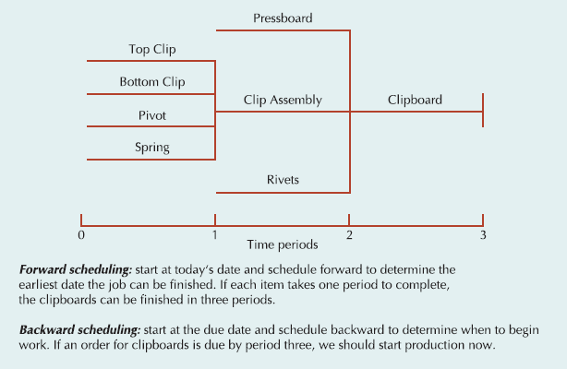
Time-phased bills
A time-phased bill of material, also known as a time-phased assembly chart, is basically a horizontal product structure diagram that graphically shows the lead time required to purchase or manufacture an item.
An MRP system can forward schedule or backward schedule production.

Slide 21
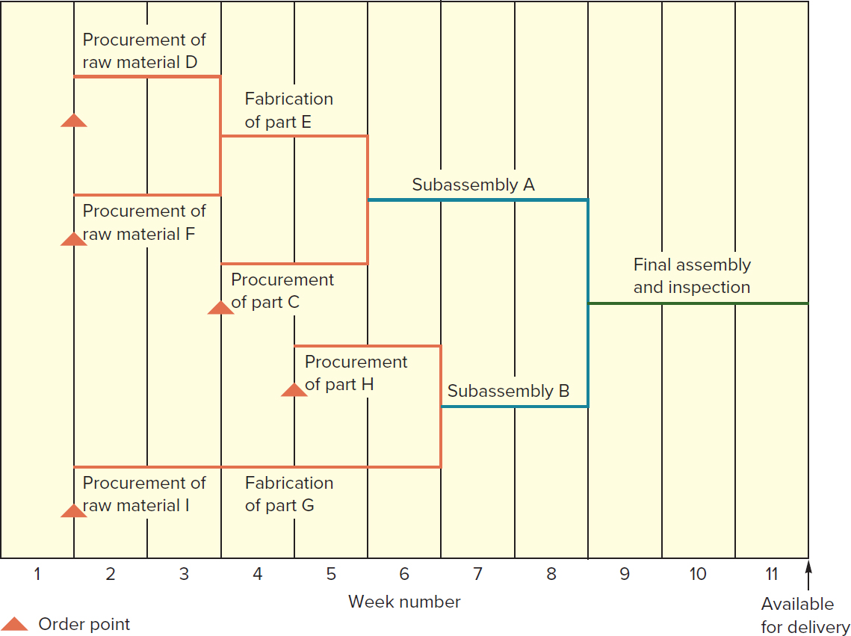
Time-phased bills Example

Slide 22
Item Master File
The item master file, or inventory file, contains an extensive amount of information on every item that is produced, ordered, or inventoried in the system.
It includes data such as on-hand quantities, on-order quantities, lot sizes, safety stock, lead time, and past usage figures.
It provides a detailed description of the item, specifies the inventory policy, updates the physical inventory count, summarizes the item’s year-to-date or month-to-date usage, and provides internal codes to link this file with other related information in the MRP database.
This involves—
maintaining orderly stockrooms;
establishing and enforcing procedures for inventory withdrawal;
ensuring prompt and accurate entry of inventory transactions;
Taking physical inventory count on a regular basis; and
reconciling inventory discrepancies in a timely manner.

Slide 23
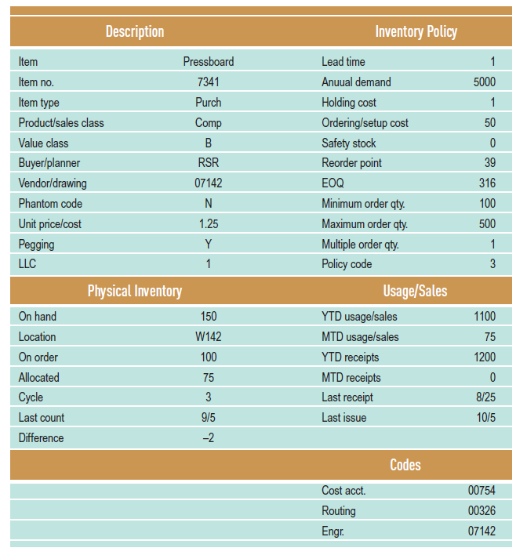
Item Master File

Slide 24
Quick Review
MCQ
Correct Answer: B
Firms making many different final products use ________ to facilitate production scheduling.
A) planning bills
B) modular bills
C) phantom bills
D) overdue bills

Slide 25
Quick Review
True or False
Correct Answer: False
"Phantom bills" are bills of material for subassemblies that do not exist in reality.

Slide 26
Quick Review
True or False
Correct Answer: True
The time-phased product structure, unlike the bill of material, adds the concept of lead times.

Slide 27
The MRP process
The MRP process consists of four basic steps:
Exploding the bill of material,
Netting out inventory,
Lot sizing, and
Time-phasing requirements.
The process is performed again and again, moving down the product structure until all items have been scheduled.
Identifying information at the top of the matrix includes the item name or number, the lowest level at which the item appears in the product structure (called low level code or LLC),
The quantities in which an item is usually made or purchased (called lot size)

Slide 28
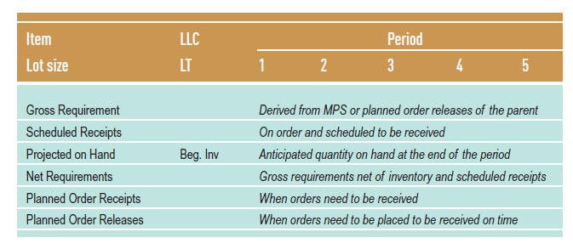
MRP matrix

Slide 29
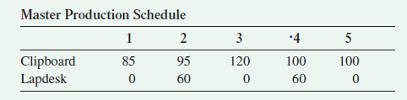
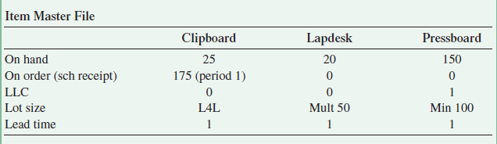
Example— School mate products
School Mate offers a number of standard products to encourage writing outside of the classroom, including clipboards, lapdesks, lapboards, and pencil boxes. Rising costs and inventory levels have prompted the company to install a computerized planning and control system called MRP. The MPS and bill of material modules are up and running. Sample output follows. Before going live with the MRP module, School Mate has asked for a manual demonstration. Since manual calculations can be quite tedious, you have decided to prepare MRP matrices for only three items—the clipboard and lapdesk, and a common component, pressboard. The master production schedule, abbreviated product structure diagrams, and inventory information are given below.

Slide 30
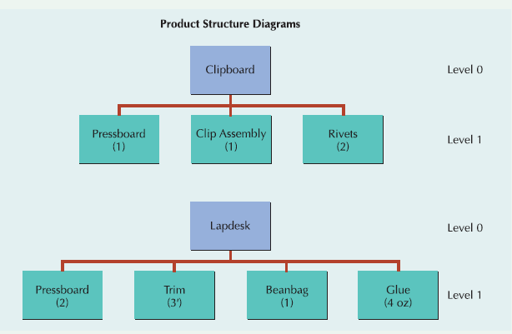
Example— School mate products

Slide 31
Example— School mate products
ITEM: CLIPBOARD LLC: 0 PERIOD
LOT SIZE: L4L LT: 1 1 2 3 4 5
ITEM: CLIPBOARD LLC: 0 PERIOD
LOT SIZE: L4L LT: 1 1 2 3 4 5
ITEM: CLIPBOARD LLC: 0 PERIOD
LOT SIZE: L4L LT: 1 1 2 3 4 5
ITEM: CLIPBOARD LLC: 0 PERIOD
LOT SIZE: L4L LT: 1 1 2 3 4 5
ITEM: CLIPBOARD LLC: 0 PERIOD
LOT SIZE: L4L LT: 1 1 2 3 4 5
Gross Requirements 85 95 120 100 100
Scheduled Receipts 175
Projected on Hand 25 115
Net Requirements 0
Planned Order Receipts
Planned Order Releases
Gross Requirements 85 95 120 100 100
Scheduled Receipts 175
Projected on Hand 25 115 20 0 0 0
Net Requirements 0 0 100 100 100
Planned Order Receipts 100 100 100
Planned Order Releases 100 100 100
Gross Requirements 85 95 120 100 100
Scheduled Receipts 175
Projected on Hand 25 115 20
Net Requirements 0 0
Planned Order Receipts
Planned Order Releases
Gross Requirements 85 95 120 100 100
Scheduled Receipts 175
Projected on Hand 25 115 20 0
Net Requirements 0 0 100
Planned Order Receipts 100
Planned Order Releases 100
Gross Requirements 85 95 120 100 100
Scheduled Receipts 175
Projected on Hand 25
Net Requirements
Planned Order Receipts
Planned Order Releases
20 units available
(20 - 120) = -100 — 100 additional Clipboards are required
Order must be placed in Period 2 to be received in Period 3
(25 + 175) = 200 units available
(200 - 85) = 115 on hand at the end of Period 1
115 units available
(115 - 95) = 20 on hand at the end of Period 2
Following the same logic Gross Requirements in Periods 4 and 5 develop Net Requirements, Planned Order Receipts, and Planned Order Releases

Slide 32
Example— School mate products
ITEM: LAPDESK LLC: 0 PERIOD
LOT SIZE: MULT 50 LT: 1 1 2 3 4 5
ITEM: LAPDESK LLC: 0 PERIOD
LOT SIZE: MULT 50 LT: 1 1 2 3 4 5
Gross Requirements 0 60 0 60 0
Scheduled Receipts
Projected on Hand 20
Net Requirements
Planned Order Receipts
Planned Order Releases
Gross Requirements 0 60 0 60 0
Scheduled Receipts
Projected on Hand 20 20 10 10 0 0
Net Requirements 0 40 50
Planned Order Receipts 50 50
Planned Order Releases 50 50
Following the same logic, the Lapdesk MRP matrix is completed as shown

Slide 33
Example— School mate products
ITEM: CLIPBOARD LLC: 0 PERIOD
LOT SIZE: L4L LT: 1 1 2 3 4 5
ITEM: CLIPBOARD LLC: 0 PERIOD
LOT SIZE: L4L LT: 1 1 2 3 4 5
Planned Order Releases 100 100 100
Planned Order Releases 100 100 100
x1
x1
x1
ITEM: LAPDESK LLC: 0 PERIOD
LOT SIZE: MULT 50 LT: 1 1 2 3 4 5
ITEM: LAPDESK LLC: 0 PERIOD
LOT SIZE: MULT 50 LT: 1 1 2 3 4 5
Planned Order Releases 50 50
Planned Order Releases 50 50
x2
x2
ITEM: PRESSBOARD LLC: 1 PERIOD
LOT SIZE: MIN 100 LT: 1 1 2 3 4 5
ITEM: PRESSBOARD LLC: 1 PERIOD
LOT SIZE: MIN 100 LT: 1 1 2 3 4 5
Gross Requirements
Scheduled Receipts
Projected on Hand 150
Net Requirements
Planned Order Receipts
Planned Order Releases
Gross Requirements 100 100 200 100 0
Scheduled Receipts
Projected on Hand 150
Net Requirements
Planned Order Receipts
Planned Order Releases

Slide 34
Example— School mate products
ITEM: CLIPBOARD LLC: 0 PERIOD
LOT SIZE: L4L LT: 1 1 2 3 4 5
Planned Order Releases 100 100 100
ITEM: LAPDESK LLC: 0 PERIOD
LOT SIZE: MULT 50 LT: 1 1 2 3 4 5
Planned Order Releases 50 50
ITEM: PRESSBOARD LLC: 1 PERIOD
LOT SIZE: MIN 100 LT: 1 1 2 3 4 5
Gross Requirements 100 100 200 100 0
Scheduled Receipts
Projected on Hand 150 50 50 0 0 0
Net Requirements 50 150 100
Planned Order Receipts 100 150 100
Planned Order Releases 100 150 100

Slide 35
Example— School mate products
Planned Order Report
PERIOD
ITEM 1 2 3 4 5
Clipboard 100 100 100
Lapdesk 50 50
Pressboard 100 150 100

Slide 36
Lot sizing in MRP systems
Although the L4L approach is most consistent with the objectives of MRP,
But, in some circumstances, it is useful to order an amount different from what is needed. For example,
Minimum order quantities are typically used to take advantage of purchasing or shipping discounts, or to conform to vendor requirements,
Maximum order quantities are used for large or expensive items when space or funds are limited, and
Multiple order quantities accommodate packaging restrictions.
Economic order quantity (EOQ)
Periodic order quantity (POQ)

Slide 37
Economic Order Quantity
The EOQ can be adapted for use with MRP if it is treated as a minimum order quantity.
In addition, annual demand, D, is replaced with average demand per period, d, and carrying cost, Cc, is converted to a per-period amount.
The EOQ is used only sparingly, usually at the finished product or raw material level, and does not perform well when demand is highly variable.

Slide 38
Periodic Order Quantity
The periodic order quantity (POQ) was created as a variation of the EOQ more suited to variable demand.
POQ is calculated by dividing the EOQ by average demand. It represents the number of demand periods covered by each order.
Thus, if the POQ were three, an order would be placed for three weeks worth of demand.

Slide 39
Lot sizing in MRP systems Example
The Lifetime Sports Company has been using MRP to manufacture sports equipment for a number of years. Recently, Bob Sage, the operations manager, decided to investigate the use of lot sizing for MRP-generated orders. As a test case, Bob selected a typical product in their line of fishing rods and gathered weekly data over a month’s time. Ordering costs are $60 per order, and carrying costs are $1 per unit per week. The beginning inventory is 30 units, and lead time is one week. Help Bob determine whether the L4L, EOQ or POQ lot sizing technique is more appropriate.
Solution: (a) L4L
Co = $60
Cc = $1
d = (30 + 50 + 20 + 10 + 40)/5 = 30
Period | 1 | 2 | 3 | 4 | 5
Gross requirement | 30 | 50 | 20 | 10 | 40

Slide 40
Lot sizing in MRP systems Example
With L4L, orders are placed for the exact amount needed.
Total cost is calculated as (number of orders X ordering cost) + (total projected on hand X carrying cost).
Item: Rod LLC: 0 Period
Lot Size: L4L LT: 1 | 1 | 2 | 3 | 4 | 5
Gross Requirements | 30 | 50 | 20 | 10 | 40
Scheduled Receipts
Projected on Hand 30 | 0 | 0 | 0 | 0 | 0
Net Requirements |  | 50 | 20 | 10 | 40
Planned Order Receipts |  | 50 | 20 | 10 | 40
Planned Order Releases | 50 | 20 | 10 | 40
Total cost of L4L = (4 * $60) + (0 * $1) = $240

Slide 41
Lot sizing in MRP systems Example
(b) EOQ
2(30)(60)
(1)
EOQ =
EOQ = 60 minimum order quantity
Item: Rod LLC: 0 Period
Lot Size: EOQ 60 LT: 1 | 1 | 2 | 3 | 4 | 5
Gross Requirements | 30 | 50 | 20 | 10 | 40
Scheduled Receipts
Projected on Hand 30 | 0 | 10 | 50 | 40 | 0
Net Requirements |  | 50 | 10
Planned Order Receipts |  | 60 | 60
Planned Order Releases | 60 | 60
Total cost of EOQ = (2 * $60)+ [(10 + 50 + 40) * $1] = $220

Slide 42
Lot sizing in MRP systems Example
(c) POQ
POQ = Q/d = 60/30 = 2 periods worth of requirements
Item: Rod LLC: 0 Period
Lot Size: POQ 2 LT: 1 | 1 | 2 | 3 | 4 | 5
Gross Requirements | 30 | 50 | 20 | 10 | 40
Scheduled Receipts
Projected on Hand 30 | 0 | 20 | 0 | 40 | 0
Net Requirements |  | 50 |  | 10
Planned Order Receipts |  | 70 |  | 50
Planned Order Releases | 70 |  | 50
Total cost of POQ = (2 * $60) + [(20 + 40) * $1] = $180
POQ is the lowest cost lot sizing technique.

Slide 43
MRP outputs
The outputs of the MRP process are planned orders from the planned order release row of the MRP matrix.
These can represent work orders to be released to the shop floor for in-house production or purchase orders to be sent to outside suppliers.
MRP output can also recommend changes in previous plans or existing schedules.
One of the advantages of the MRP system is its ability to show the effect of change in one part of the production process on the rest of the system.

Slide 44
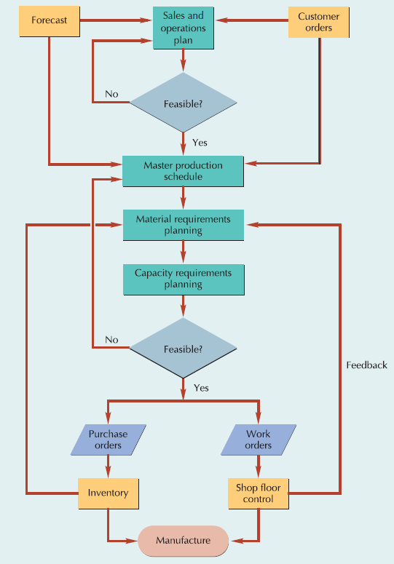
Manufacturing Resource Planning (MRP II)

Slide 45
Manufacturing Resource Planning (MRP II)

Slide 46
Manufacturing Resource Planning (MRP II)

Slide 47
Capacity Requirements Planning (CRP)
Capacity requirements planning (CRP) is a computerized system that projects the load from a given material plan onto the capacity of a system and identifies underloads and overloads.
It is then up to the MRP planner to level the load—smooth out the resource requirements so that capacity constraints are not violated.
This can be accomplished by shifting requirements, reducing requirements, or temporarily expanding capacity.

Slide 48
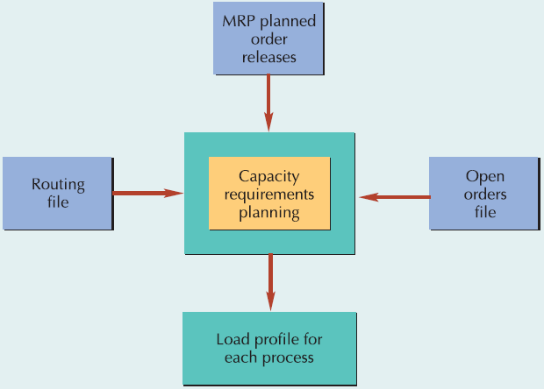
Capacity Requirements Planning (CRP)

Slide 49
Calculating Capacity
Capacity is the maximum capability to produce.
It can be measured as units of output, dollars of output, hours of work, or number of customers processed over a specified period of time.
Capacity= (no. machines or workers) x (no. shifts) x (hours/shift) x (utilization) x (efficiency)

Slide 50
Capacity Terms
Load profile
  Compares planned orders released with work center capacity
Utilization
  % of available working time spent working
Efficiency
Load
  The standard hours of work assigned to a facility
Load percent
  The ratio of load to capacity
  Load % = (load/capacity)x100%

Slide 51
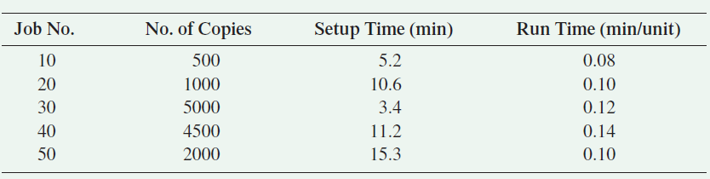
Determining Loads and Capacities Example
Copy Courier (CC) is a fledgling copy center in downtown Richmond run by two college students. Currently, the equipment consists of two high-speed copiers that can be operated by one operator. If the students work alone, it is conceivable that two shifts per day can be staffed. The students each work 8 hours a day, 5 days a week. They do not take breaks during the day, but they do allow themselves 30 minutes for lunch or dinner. In addition, they service the machines for about 30 minutes at the beginning of each shift. The time required to set up for each order varies by the type of paper, use of color, number of copies, and so on. Estimates of setup time are kept with each order. Since the machines are new, their efficiency is estimated at 90%. Due to extensive advertising and new customer incentives, orders have been pouring in. The students need help determining the capacity of their operation and the current load on their facility. Use the following information to calculate the normal daily capacity of Copy Courier and to project next Monday’s load and load percent.

Slide 52
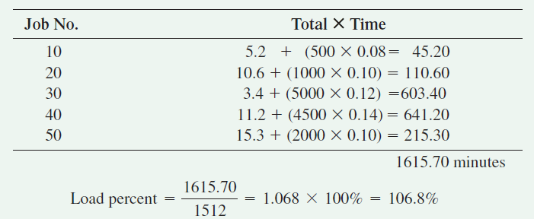
Determining Loads and Capacities Example
Solution
The machines and operators at Copy Courier are out of service for 1 hour each shift for maintenance and lunch. Utilization is thus 7/8, or 87.5%.
Daily copy shop capacity is:
2 machines * 2 shifts * 8 hours>shift * 90% efficiency * 87.5% utilization = 25.2 hours or 1512 minutes
The projected load for Monday of next week is as follows:

Slide 53
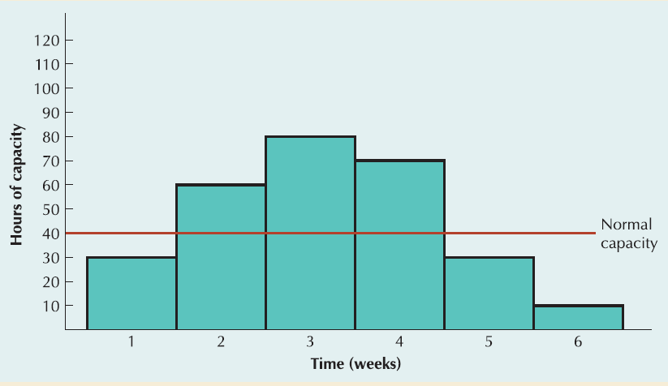
Load Profiles
Load profiles are a graphical comparison of load versus capacity.
We can see that the machine is under loaded in periods 1, 5, and 6, and overloaded in periods 2, 3, and 4.

Slide 54
Remedies for Underloads
Acquire more work
Pull work ahead that is scheduled for later time periods
Reduce normal capacity

Slide 55
Remedies for Overloads
Eliminate unnecessary requirements
Reroute jobs to alternative machines or work centers
Split lots between two or more machines
Increase normal capacity
Subcontract
Increase the efficiency of the operation
Push work back to later time periods
Revise master schedule

Slide 56
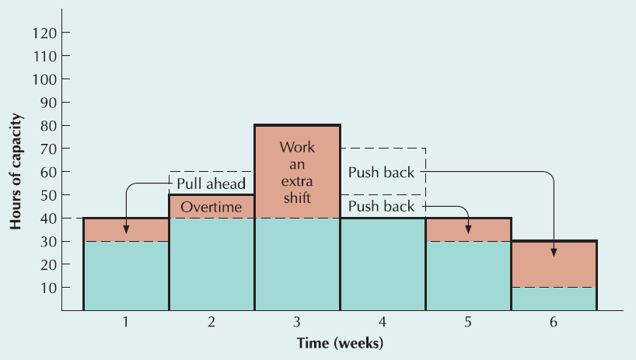
load Leveling
This process of balancing underloads and overloads is called load leveling.

Slide 57
Relaxing MRP Assumptions
Today’s ERP technology allows us to relax some of the more restrictive assumptions of MRP. Like—
Material is not always the constraining resource
Lead times can vary
Not every transaction needs to be recorded
JIT can be used with MRP
The shop floor may require a more sophisticated scheduling system

Slide 58


Thank You

